Slide 1

The IoT of Automation
A Totally New Way to Look at Control and Automation in the Process Industries
Presented by: Donald C. Clark
VP Industries and Schneider Master Expert Edison Fellow
Process Automation Business
LCCC Process Control Workshop, September 28-30, 2016
Lund University, Lund, Sweden

Slide 2

“A Control System Without Field Devices is Nothing But a Brain in a Jar…”
This is how we now tend to think of modern industrial control systems…
We’ve forgotten about the field…
Measurement is no longer mentioned in polite circles…
“…what’s a valve?”
We’ve even forgotten about control…
“They’re just a computer…”
“…just like any other computer…”
When it comes to process control and automation, how should we approach “IoT”?

Slide 3
Introduction
Process control: to keep a process safe and operating to design to produce economic value for the asset owners…
…has been with us since the earliest days of the industrial revolution…and…
…will always persist…and will never go away.
How we solve/address those challenges – the platform on which the control is executed – ie the “automation”…
…has changed over time…and will radically change in the future.
The “intelligence” to achieve this objective is being pushed further and further “down” the architecture, and the traditional process control “Levels” are being compressed over time closer to the valve and the sensor…and to the process itself.
There will ALWAYS be the conversion process itself…and its process equipment: pipes, vessels, pumps, reactors, concrete, steel, catalysts, etc., but how to control that process has – and will continue – to dramatically shift over time.

Slide 4





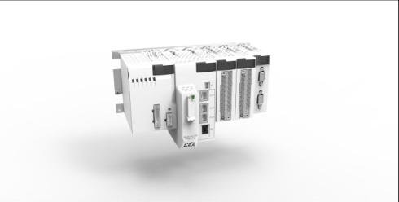
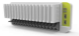
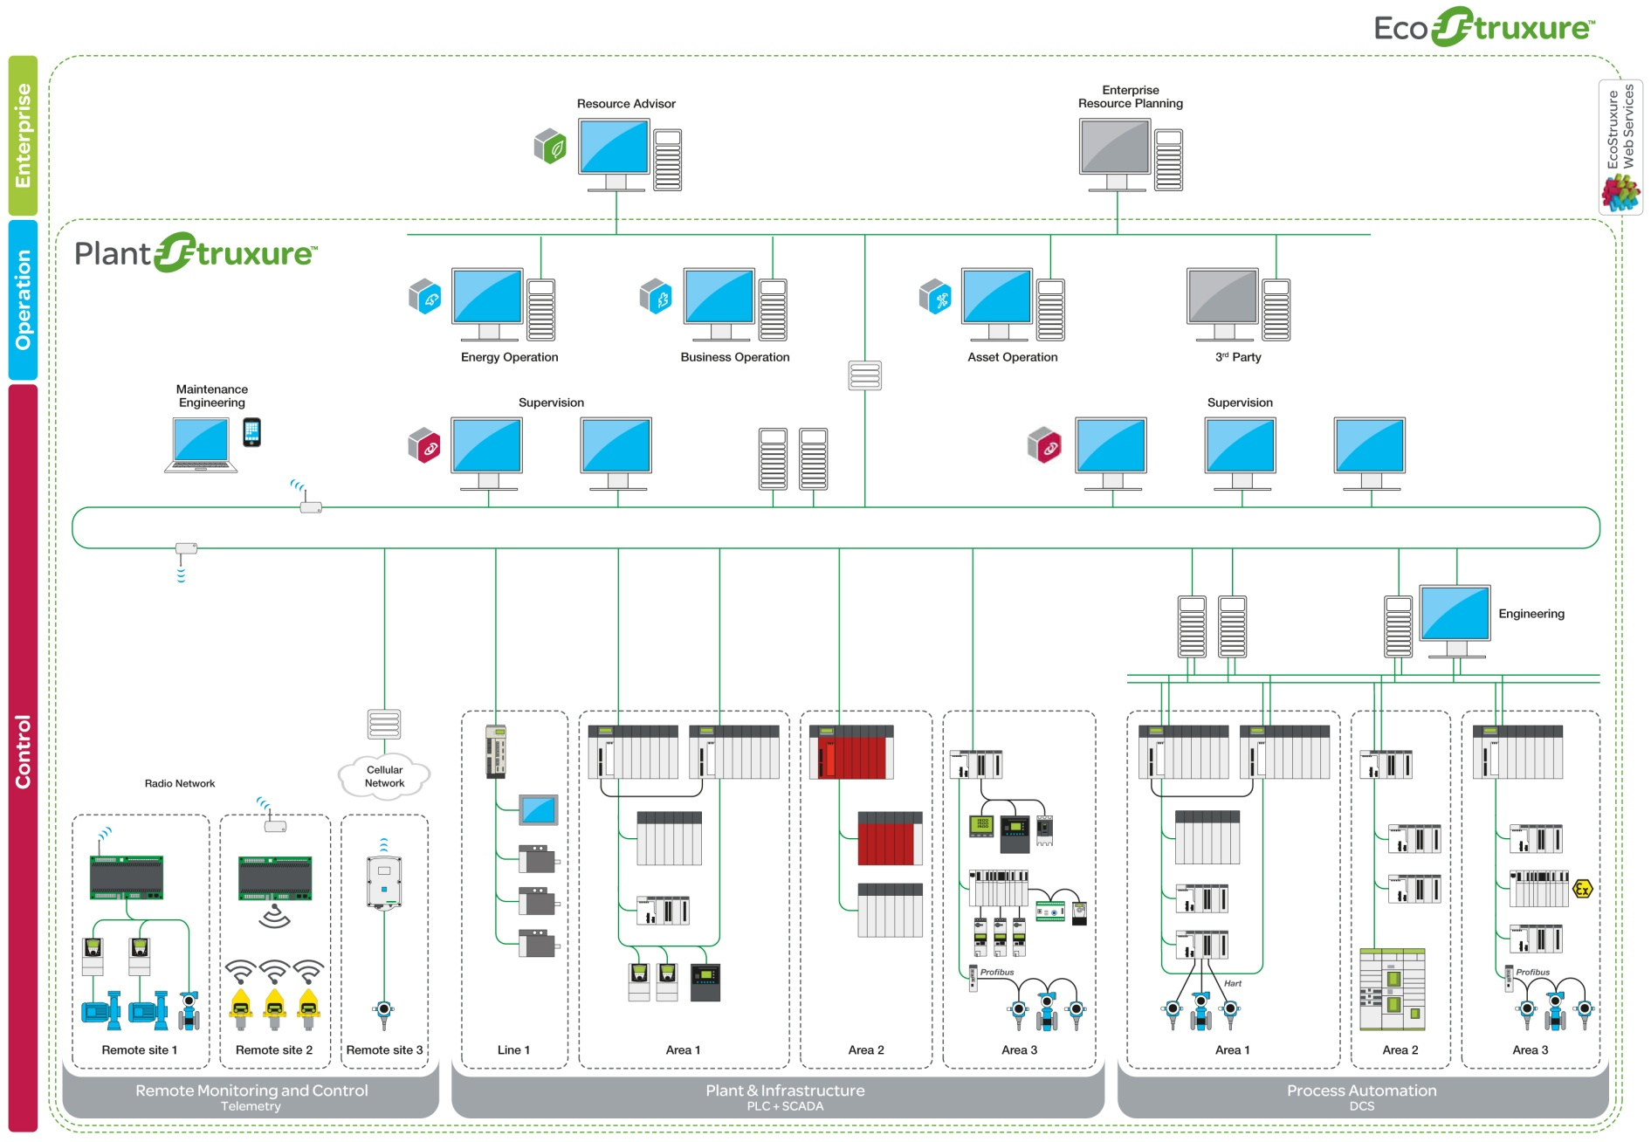
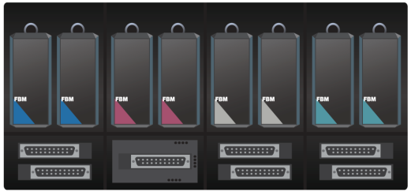




State-of-the-Art Industrial Control System
– for Four Decades
The predicament we’re in:
Operator Station
Control Room
1. Over time…
Applications
Processor
2. Were severely limited in their scope by the technologies available:
  Manual/direct human manipulation/intervention in the process
  Mechanical control (e.g. spinning ball governors, siphon level control)
  Pneumatic (huge benefit: intrinsically safe)
  Electronic
  Digital computing and microprocessors
Engineering
Station
Maintenance
Station
Number of controllers needed per system
time
No longer considered “distributed”
Risk of exposure for failure
Control
Network
Forced control to be applied on the process, as an add-on or an appendage to the process
New technologies will bring the ability to shift that century-old paradigm so that control will be performed in the process, in-situ, in the actual process devices and equipment needed for the process, not “stuck-on”.
It will become embedded and autonomous in a way to mimic what in fact occurs in the control of biological processes such as the human body: the process controls itself, it is NOT “stuck-on”.
Modicon
Integrated
Control
Redundant
Controllers
Process
Connected
Compact I/O
I/O network
Amount of control per controller
Modicon I/O bus
Modbus
Foxboro
Remote and local
Control
Modicon
Remote and local I/O

Slide 5
The Common Core Functionality (CCF)
Comms
CPU
Display
The “controller” of any brand of DCS today
…and for the past 40 years
I/O
Has been utilized for decades to architect control systems
The economies of scale and time/technology curves has put us in the predicament we’re in
“…it’s just a computer…”

Slide 6
But: Available Technology Can Now…
…put this on a chip…
…for about $3…
…to do about 8 things
Performs “a few” Control Instrumented Functions (CIF)
Comms
CPU
Display
I/O
…very rugged…
…very low power
…harvest power needed
…the size of a postage stamp
Schneider is already developing this!!
Empowers a totally new way to look at control
Allows us to return to our roots…

Slide 7





Imagine Instead…
Unified Configuration
Environment
Web
App Engines
Operator
Station
Foreign Operator
Stations (Local or Remote)
Unified Configuration
Environment
To other Units
Enterprise Service Bus (ESB)
To other Units
Operator Decision
Support Centre
Eyes
Scalable
Availability
App
Box
Batch Box
Analog Box
History
Box
1. Reduce CCF to the granularity of one, $3, and size of postage stamp: CPS
Existing Platform Integration
Equipment fog– High-Speed communications Network – meshed together
Spinal Cord – High-Speed Control & I/O Network
Spinal Cord – High-Speed Control & I/O Network
Spinal Cord – High-Speed Control & I/O Network
Unified Configuration
Environment
2. Low-level "fog" of communications "clinging" to the equipment via meshing
Intrinsically secure/immune to hacking by distance
IM
IM-S
IM
IM
IM
IM
IM
IM
IM
IM
IM
Universal I/O
Loop I/O
Safety I/O
High Density
I/O
FF
HART
IEC61850
Devicenet
Profibus
MTU
Other I/O ?
3rd Party
PLC
&
Control Safety
PAC
Triconex
IA series
SCADA
Core Velocity
Minimum Velocity
Core Velocity
Comms Personality
CPU
Display Optional
Comms Personality
CPU
Display Optional
Up to 5K points per process cell
3. Use power harvested from surroundings
Up to 5K points per process cell
I/O Personality
I/O Personality
I/O System
I/O System
I/O System
I/O System
I/O System
R-IM
R-IM
Various I/O
Various I/O
4. Control now occurs at the asset
“Cyber Physical System” (CPS)

Slide 8
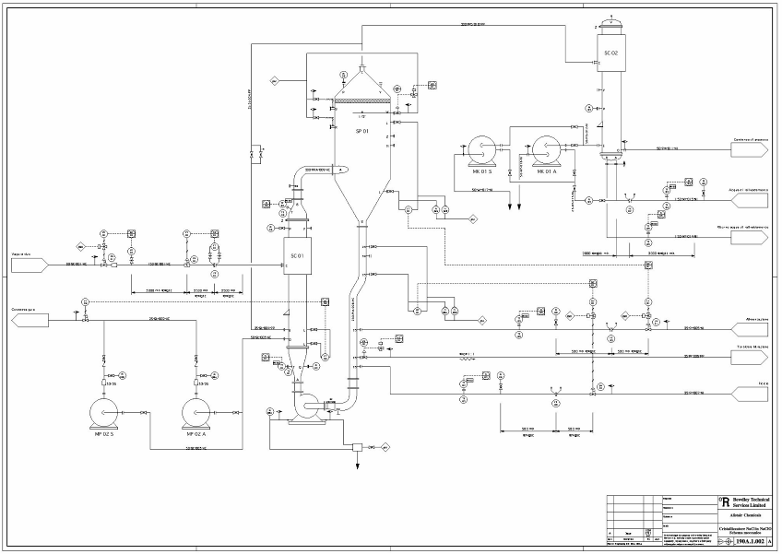
Now in a Plant Today…
= traditional process sensors & outputs/valves
= process equipment: e.g. pumps, reactors, etc.
Traditional
process sensing
and outputs are “stuck on” to the process…
…and traditionally
unmeasured devices…
…that are an integral part of the process…
Today, the hierarchical equipment relationships that form the process must be implemented – and maintained – by people. That model is constructed for the system, not by the system
…that are mini-processes in themselves…
…are usually treated as stupid (because they are), or just ignored…
And the controllers are even further removed from the process in the MCC

Slide 9
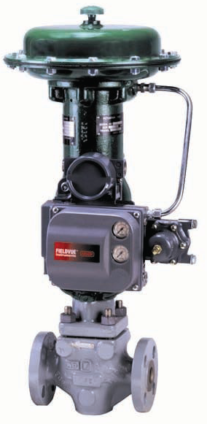
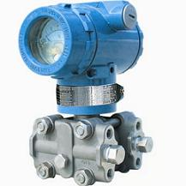
How Control at the Asset Will Change This…
For Traditional Process Sensing and Outputs…
Put measurement/control/comms CCF inside conventional sensors & valves…
…communicating via the secure highly localized communications fog
Comms Personality
CPU
Display Optional
I/O Personality
Comms Personality
CPU
Display Optional
I/O Personality
Comms Personality
CPU
Display Optional
Comms Personality
CPU
Display Optional
I/O Personality
I/O Personality
Comms Personality
CPU
Display Optional
Comms Personality
CPU
Display Optional
I/O Personality
I/O Personality
Comms Personality
CPU
Display Optional
I/O Personality
…handling routine process control – most usually with nearest neighbors
Autonomous
…as well as asset performance management - avatars
…aware of environment – self configuring (ie modeling). No need to keep models
As defined by the device vendor

Slide 10
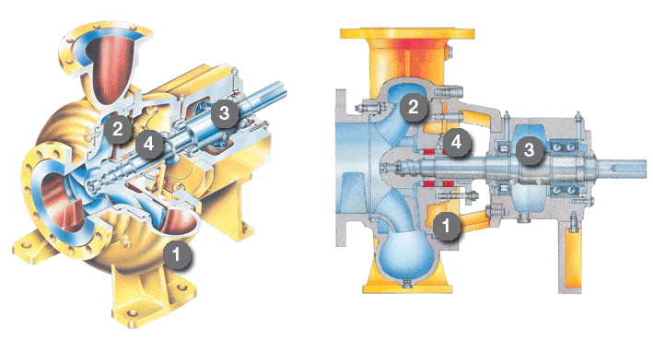
The Same Can Be Done For Traditionally Unmeasured Devices…and Equipment
Put measurement/control/comms CCF inside the asset…
… communicating via the intrinsically secure highly localized fog of communications
…as complex as a FCC power recovery turbine..
…or as humble as a length of pipe (or act as repeater)
Comms Personality
CPU
Display Optional
Comms Personality
CPU
Display Optional
Comms Personality
CPU
Display Optional
I/O Personality
I/O Personality
I/O Personality
Comms Personality
CPU
Display Optional
Comms Personality
CPU
Display Optional
Comms Personality
CPU
Display Optional
I/O Personality
I/O Personality
I/O Personality
…empowering equipment at the very edge of the process
…with the vendor’s IP – they know their equipment the best
Comms Personality
CPU
Display Optional
Comms Personality
CPU
Display Optional
I/O Personality
I/O Personality
…handling routine process control – most usually with nearest neighbors
…as well as asset performance management - avatars
Autonomous
…aware of environment – self configuring (ie modeling). No need to keep models
As defined by the equipment vendor

Slide 11
So Now Our Plant Looks Like…
Control Room
Harness “WinTel”/Internet domain
With a control granularity approaching one
Totally and truly “distributed control”
Self identifying and autonomous to reduce configuration and modeling costs
Built-in security
Fail-safe robustness and redundancy only where needed
Provides unprecedented scalability
“Control” is sold with the equipment itself, not “stuck-on”
Provides inherent asset performance intelligence
The “Internet of Things” as it applies to automation
Unified Configuration
Environment
App Engines
Operator
Station
Web
Non-Velocity Operator
Stations (Local or Remote)
Unified Configuration
Environment
To other Units
Enterprise Service Bus (ESB)
To other Units
Operator Decision
Support Centre
Eyes
Comms Personality
CPU
Display Optional
Comms Personality
CPU
Display Optional
Comms Personality
CPU
Display Optional
Comms Personality
CPU
Display Optional
Comms Personality
CPU
Display Optional
Comms Personality
CPU
Display Optional
Comms Personality
CPU
Display Optional
Comms Personality
CPU
Display Optional
Voice Box
Batch Brain
Analog Brain
Pain Centre
I/O Personality
I/O Personality
I/O Personality
I/O Personality
I/O Personality
I/O Personality
Wireless Spinal Cord – High-Speed Control & I/O Network
Comms Personality
CPU
Display Optional
I/O Personality
I/O Personality
I/O Personality
Comms Personality
CPU
Display Optional
Comms Personality
CPU
Display Optional
Comms Personality
CPU
Display Optional
Comms Personality
CPU
Display Optional
I/O Personality
Comms Personality
CPU
Display Optional
Comms Personality
CPU
Display Optional
I/O Personality
Comms Personality
CPU
Display Optional
Comms Personality
CPU
Display Optional
Comms Personality
CPU
Display Optional
Comms Personality
CPU
Display Optional
Comms Personality
CPU
Display Optional
I/O Personality
I/O Personality
Comms Personality
CPU
Display Optional
Comms Personality
CPU
Display Optional
Comms Personality
CPU
Display Optional
Comms Personality
I/O Personality
Comms Personality
CPU
Display Optional
I/O Personality
Comms Personality
CPU
Display Optional
CPU
Display Optional
Comms Personality
CPU
Display Optional
I/O Personality
I/O Personality
I/O Personality
I/O Personality
I/O Personality
I/O Personality
I/O Personality
I/O Personality
I/O Personality
I/O Personality
Wireless Spinal Cord – High-Speed Control & I/O Network
Wireless Spinal Cord – High-Speed Control & I/O Network
Comms Personality
CPU
Display Optional
I/O Personality
I/O Personality
I/O Personality
Comms Personality
CPU
Display Optional
Comms Personality
CPU
Display Optional
Comms Personality
CPU
Display Optional
Comms Personality
CPU
Display Optional
Comms Personality
CPU
Display Optional
Comms Personality
CPU
Display Optional
Comms Personality
CPU
Display Optional
Comms Personality
CPU
Display Optional
Comms Personality
CPU
Display Optional
Comms Personality
CPU
Display Optional
I/O Personality
Unified Configuration
Environment
I/O Personality
I/O Personality
I/O Personality
I/O Personality
I/O Personality
Comms Personality
CPU
Display Optional
I/O Personality
Comms Personality
CPU
Display Optional
Comms Personality
CPU
Display Optional
Comms Personality
CPU
Display Optional
I/O Personality
I/O Personality
I/O Personality
Wireless Spinal Cord – High-Speed Control & I/O Network
Comms Personality
CPU
Display Optional
I/O Personality
I/O Personality
Comms Personality
CPU
Display Optional
I/O Personality
Comms Personality
CPU
Display Optional
Comms Personality
CPU
Display Optional
Comms Personality
CPU
Display Optional
I/O Personality
I/O Personality
I/O Personality
I/O Personality
Comms Personality
CPU
I/O Personality
Comms Personality
CPU
Display Optional
Comms Personality
CPU
Display Optional
Comms Personality
CPU
Display Optional
I/O Personality
Display Optional
I/O Personality
I/O Personality
Comms Personality
CPU
Display Optional
Comms Personality
CPU
Display Optional
Comms Personality
CPU
Display Optional
Comms Personality
CPU
Display Optional
Comms Personality
CPU
Display Optional
I/O Personality
I/O Personality
I/O Personality
I/O Personality
I/O Personality
I/O Personality
Comms Personality
CPU
Display Optional
I/O Personality
I/O Personality
Comms Personality
CPU
Display Optional
Comms Personality
CPU
Display Optional
Comms Personality
CPU
Display Optional
Comms Personality
CPU
Display Optional
Comms Personality
CPU
Display Optional
Comms Personality
CPU
Display Optional
Comms Personality
CPU
Display Optional
Comms Personality
CPU
Display Optional
I/O Personality
I/O Personality
I/O Personality
I/O Personality
I/O Personality
I/O Personality
Wireless Spinal Cord – High-Speed Control & I/O Network
Comms Personality
CPU
Display Optional
I/O Personality
I/O Personality
I/O Personality
Comms Personality
CPU
Display Optional
Comms Personality
CPU
Display Optional
Comms Personality
CPU
Display Optional
Comms Personality
CPU
Display Optional
I/O Personality
I/O Personality
Comms Personality
CPU
Display Optional
Comms Personality
CPU
Display Optional
Comms Personality
CPU
Display Optional
Comms Personality
CPU
Display Optional
Comms Personality
CPU
Display Optional
I/O Personality
I/O Personality
I/O Personality
I/O Personality
I/O Personality
I/O Personality
Comms Personality
CPU
Display Optional
I/O Personality
I/O Personality
Process
Connected
Comms Personality
CPU
Display Optional
Comms Personality
CPU
Display Optional
Comms Personality
CPU
Display Optional
Comms Personality
CPU
Display Optional
Comms Personality
CPU
Display Optional
Comms Personality
CPU
Display Optional
Comms Personality
CPU
Display Optional
Comms Personality
CPU
Display Optional
I/O Personality
I/O Personality
I/O Personality
I/O Personality
I/O Personality
I/O Personality
Wireless Spinal Cord – High-Speed Control & I/O Network
Comms Personality
CPU
Display Optional
I/O Personality
I/O Personality
I/O Personality
Comms Personality
CPU
Display Optional
Comms Personality
CPU
Display Optional
Comms Personality
CPU
Display Optional
Comms Personality
CPU
Display Optional
Comms Personality
CPU
Display Optional
Comms Personality
CPU
Display Optional
Comms Personality
CPU
Display Optional
Comms Personality
CPU
Display Optional
Comms Personality
CPU
Display Optional
I/O Personality
I/O Personality
I/O Personality
I/O Personality
I/O Personality
I/O Personality
I/O Personality
Comms Personality
CPU
Display Optional
Wireless Spinal Cord – High-Speed Control & I/O Network
Comms Personality
CPU
Display Optional
I/O Personality
I/O Personality
Comms Personality
CPU
Display Optional
Comms Personality
CPU
Display Optional
Comms Personality
CPU
Display Optional
Comms Personality
CPU
Display Optional
I/O Personality
I/O Personality
Comms Personality
CPU
Display Optional
I/O Personality
I/O Personality
Comms Personality
CPU
Display Optional
Comms Personality
CPU
Display Optional
Comms Personality
CPU
Display Optional
Comms Personality
CPU
Display Optional
I/O Personality
I/O Personality
Comms Personality
CPU
Display Optional
Comms Personality
CPU
Display Optional
Comms Personality
CPU
Display Optional
I/O Personality
I/O Personality
I/O Personality
I/O Personality
I/O Personality
I/O Personality
Comms Personality
CPU
Display Optional
Comms Personality
CPU
Display Optional
Comms Personality
CPU
Display Optional
Comms Personality
CPU
Display Optional
Comms Personality
CPU
Display Optional
I/O Personality
I/O Personality
I/O Personality
I/O Personality
I/O Personality
I/O Personality
Comms Personality
CPU
Display Optional
I/O Personality
I/O Personality
Comms Personality
CPU
Display Optional
Comms Personality
CPU
Display Optional
Comms Personality
CPU
Display Optional
Comms Personality
CPU
Display Optional
Comms Personality
CPU
Display Optional
Comms Personality
CPU
Display Optional
Comms Personality
CPU
Display Optional
Comms Personality
CPU
Display Optional
I/O Personality
I/O Personality
I/O Personality
I/O Personality
I/O Personality
I/O Personality
Wireless Spinal Cord – High-Speed Control & I/O Network
Comms Personality
CPU
Display Optional
I/O Personality
I/O Personality
I/O Personality
Comms Personality
CPU
Display Optional
Comms Personality
CPU
Display Optional
Comms Personality
CPU
Display Optional
Comms Personality
CPU
Display Optional
I/O Personality
I/O Personality
Comms Personality
CPU
Display Optional
Comms Personality
CPU
Display Optional
Comms Personality
CPU
Display Optional
Comms Personality
CPU
Display Optional
Comms Personality
CPU
Display Optional
I/O Personality
I/O Personality
Comms Personality
CPU
Display Optional
Comms Personality
CPU
Display Optional
Comms Personality
CPU
Display Optional
I/O Personality
I/O Personality
I/O Personality
I/O Personality
Comms Personality
CPU
Display Optional
I/O Personality
Comms Personality
CPU
Display Optional
I/O Personality
I/O Personality
I/O Personality
Comms Personality
CPU
Display Optional
Comms Personality
CPU
Display Optional
Comms Personality
CPU
Display Optional
Comms Personality
CPU
Display Optional
I/O Personality
I/O Personality
I/O Personality
I/O Personality
Wireless Spinal Cord – High-Speed Control & I/O Network
Comms Personality
CPU
Display Optional
I/O Personality
I/O Personality
I/O Personality
Comms Personality
CPU
Display Optional
Comms Personality
CPU
Display Optional
Comms Personality
CPU
Display Optional
Comms Personality
CPU
Display Optional
I/O Personality
I/O Personality
Comms Personality
CPU
Display Optional
Comms Personality
CPU
Display Optional
Comms Personality
CPU
Display Optional
Comms Personality
CPU
Display Optional
Comms Personality
CPU
Display Optional
I/O Personality
I/O Personality
I/O Personality
I/O Personality
I/O Personality
I/O Personality
Comms Personality
CPU
Display Optional
I/O Personality
I/O Personality
Comms Personality
CPU
Display Optional
Comms Personality
CPU
Display Optional
Comms Personality
CPU
Display Optional
Comms Personality
CPU
Display Optional
Comms Personality
CPU
Display Optional
Comms Personality
CPU
Display Optional
Comms Personality
CPU
Display Optional
Comms Personality
CPU
Display Optional
I/O Personality
I/O Personality
I/O Personality
I/O Personality
I/O Personality
I/O Personality
Wireless Spinal Cord – High-Speed Control & I/O Network
Comms Personality
CPU
Display Optional
I/O Personality
I/O Personality
I/O Personality
Comms Personality
CPU
Display Optional
Comms Personality
CPU
Display Optional
Comms Personality
CPU
Display Optional
Comms Personality
CPU
Display Optional
I/O Personality
I/O Personality
Comms Personality
CPU
Display Optional
Comms Personality
CPU
Display Optional
Comms Personality
CPU
Display Optional
Comms Personality
CPU
Display Optional
Comms Personality
CPU
Display Optional
I/O Personality
I/O Personality
I/O Personality
I/O Personality
I/O Personality
I/O Personality
Comms Personality
CPU
Display Optional
I/O Personality
I/O Personality
…all meshed together communicating via the highly localized fog of communications that “clings” to the process equipment only

Slide 12
Immediate Benefits
Allows for lower cost, and much more resilient and robust control as it is so close to the process, not removed/separated from it.
Redundancy granularity of one within control clusters
Self-identifying and autonomous - minimizing/eliminating configuration and modeling at control level. Any change is automatically accommodated.
Low power – can use power harvesting for needed power
Minimal/no wiring, intrinsically cyber-secure networks that follows the process
Equipment vendors impart their asset performance knowledge within device:
  First-level process control
  Asset control of the process devices and equipment themselves
  Asset performance of the process will become the norm and routine

Slide 13
Commercial Strategy…
    Schneider’s focus remains at the systems level
    Begin at the measurement and valve levels:
        Add to our own – and other’s – sensor, analytical, and valve portfolios:
        We add intelligence to otherwise stupid assets to the device OEMs, adding:
System software is key to this:
Devices are not stand-alone; are part of a system
Reliant on open, interoperable industry Standards (ISA95, OG):
  Functionality/naming definitions
  Communications
Create a “system of systems”
Each CPS has a bit of “system”: build the system CPS by CPS
          Measurement
          Control
          Diagnostics
          Communications
        Provides IP in the form of location (in device), number, type, & asset performance IP in the device
      Expand to equipment providers: they provide their IP as avatars on the CPS’s
      Current architectures can accommodate this technology allowing for systems to be a combination of current and this technology
      Move from process efficiency control to business performance control
      Traditional “advanced” functionality operating over a wide-range of assets will still be provided at the system level communicating over the fog
Notes:
Bold subheadlines [from Slide Master]
Subheadlines may be applied in Verdana Bold. These should be the same size as the body text to which they apply and should not use highlight colours or any different styling or type attributes.

Slide 14
Summary
Essentially takes conventional automation systems, chops it up to smallest granularity possible, and distributes around the process in the actual process devices and equipment, all powered by harvested power, communicating in a fog of combined meshes, operating within a unifying systems framework
Control is no longer “stuck on” – it is in situ, autonomous, part of the process
Control shifts to the device itself with added device IP by vendor
The plant models itself: control perfectly represents the actual plant
Schneider focuses on what it does best: providing the system characteristics
Maximum security, reliability and resiliency at lowest possible cost
This is the Internet of Things as applied to industrial process control:
It is functionality, not connectivity

Slide 15
Tack

